Slide 1
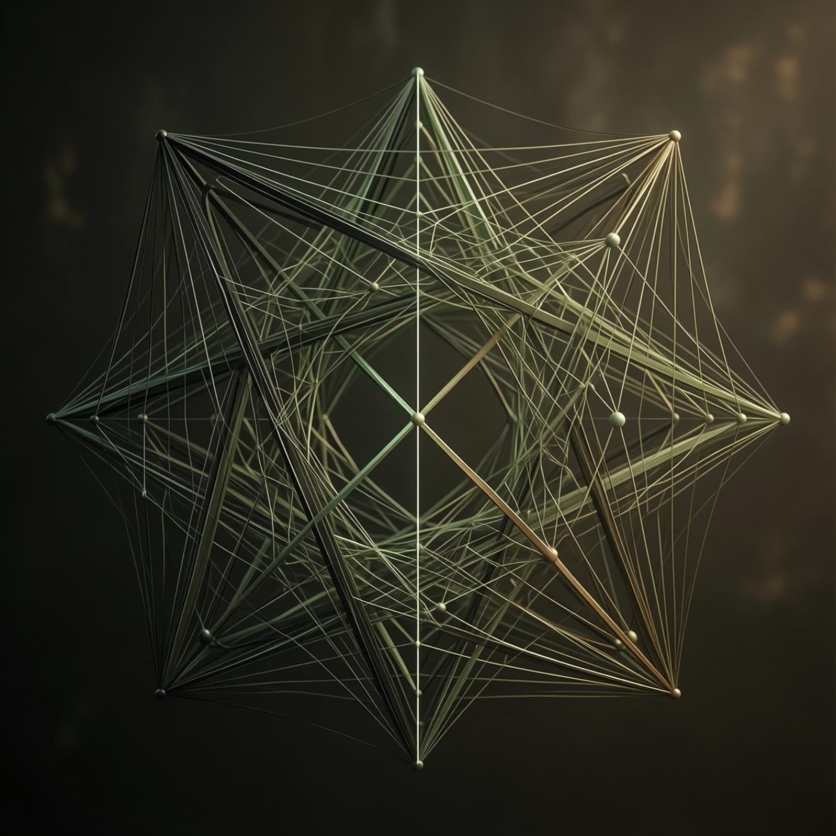
Classification Using Twin SVM
Our approach leverages a Twin Support Vector Machine (TSVM) for robust classification. Unlike traditional SVMs, TSVM constructs two non-parallel hyperplanes, each optimized to classify data points from a specific class while maximizing the margin from the other.
Builds two separating hyperplanes, significantly enhancing classification efficiency.
Offers superior speed compared to conventional Support Vector Machines.
Employs a one-versus-all strategy for effective multi-class classification.
Performs 256-class classification to determine a single key byte in AES-128.

Slide 2




Byte-Wise Attack Idea
The AES-128 key consists of 16 bytes. Our attack strategy targets these bytes individually, simplifying the complex
task of key recovery.
1. AES-128 Key Structure
2. Sequential Byte Attack
The AES-128 key is composed of 16 distinct bytes.
The attack proceeds one byte at a time, minimizing computational load.
3. Exhaustive Byte Values
4. Iterative Key Recovery
Each byte can take 256 possible values (0-255), representing all permutations.
The model first guesses one byte, then repeats the process for the remaining 15 bytes until the full key is recovered.

Slide 3
How is Key Rank Calculated?
Key rank is a critical metric for evaluating the success of a side-channel attack. It quantifies how high the correct key ranks among all possible guesses.
Calculation Steps:
Key Rank Significance:
For each key guess k, compute L = SBox(P ⊕ k), where P is plaintext.
The position of the correct key in the sorted list determines its rank.
Extract the probability associated with class L from the model's output.
A rank of 1 indicates a perfect, immediate guess of the key.
Aggregate (add) probabilities for all attack traces.
A rank of ≤ 10 signifies a very strong and successful attack, recovering the key with minimal effort.
Sort all 256 accumulated scores in descending order to establish their ranks.

Slide 4

Datasets Used
To rigorously test and validate our model, we utilized two widely recognized public datasets, ensuring our results are comparable and reproducible within the security research community.
ASCAD Dataset:
Masked AES-128 Implementation: Features traces from a protected AES implementation.
Training Traces: Comprises 50,000 power consumption traces for model training.
Attack Traces: Includes 10,000 traces specifically for testing attack effectiveness.
TeSCASE Dataset:
Masked and Unmasked AES: Provides data from both protected and unprotected AES versions.
Extensive Trace Count: Features a substantial number of traces, suitable for diverse testing scenarios.

Slide 5




Advantages of This Method
The Deep K-TSVM model offers significant advantages over existing side-channel attack techniques, setting a new benchmark for effectiveness and efficiency.
Exceptional Accuracy
Achieves very high accuracy in key byte prediction, minimizing false positives.
Low Trace Requirement
Requires very few power traces for successful key recovery, enhancing stealth.
Versatile Application
Effective against both masked and unmasked AES implementations.
Strong Generalization
Benefits from pre-training, leading to excellent generalization across different devices.

Slide 6

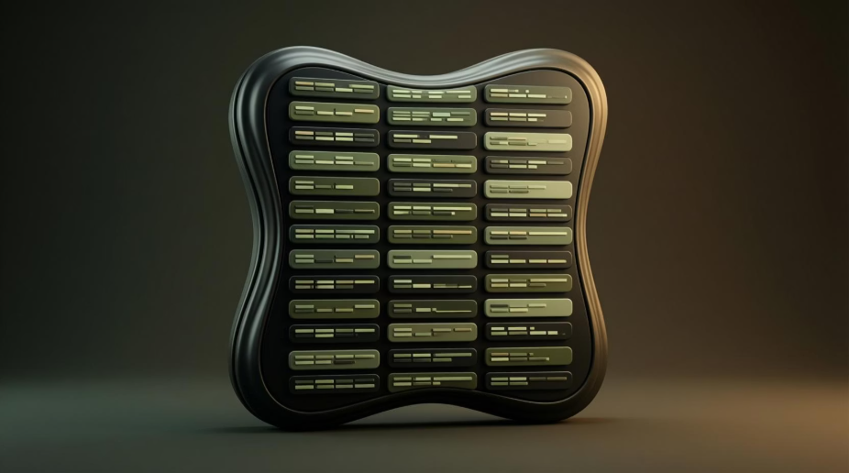


Limitations of This Work
While promising, our current work acknowledges several limitations that provide clear avenues for future research and development in side-channel analysis.
Profiled Attack Nature
Extensive Training Data
The methodology requires a copy of the target device for profiling, limiting non-profiled attack scenarios.
The training phase necessitates a large number of traces to build a robust and accurate model.
one key byte is shown in experiments
Real-World Complexity
Experiments primarily demonstrate key recovery for only one key byte, requiring further validation for all 16 bytes.
Real-world attack scenarios may present higher noise levels and additional protections, potentially impacting performance.

Slide 7










Conclusion
This research introduces a powerful new model that significantly advances the field of side-channel analysis, highlighting the growing threat of deep learning to hardware security.
Hybrid Approach
New Deep K-TSVM
Combines Restricted Boltzmann Machines (RBM) with Twin SVM.
Proposed a novel Deep K-TSVM model.
High Accuracy
Security Implications
Recovers key bytes with exceptional accuracy.
Demonstrates deep learning as a significant threat to hardware security.

Slide 8

Questions & Discussion
I welcome your questions and insights. Let's delve deeper into the implications and potential applications of this research.

Slide 9
Thank You
I appreciate your time and attention today. For further inquiries or collaborations, please feel free to reach out.

